Slide 1

ATTENDANCE TRACKING SYSTEM USING FACE RECOGNITION
Done by:
CHETAN REDDY BANDI
TANYA BANSAL

Slide 2
Introduction
Everything in the current era has become contactless, from financial transactions to education and things are carried out without any physical interaction.
Don’t you think the same cutting-edge contactless technology should be created and applied to an Attendance Tracking System in Schools and Universities?

Slide 3
Problem Statement:
•Attendance is considered as an important factor for a student as it not only marks the presence of student but is also considered a part of his/her academic record during evaluations.
•With the advancements of technology, this part of the education system is still done manually by the college faculty often resulting in minute errors or is very time consuming, especially in universities where taking attendance for every class is mandatory.
•It is indeed a difficult task to manage with the continuous increase in the number of enrollments into the institution.

Slide 4
Existing Attendance Tracking System
FingerPrint Sensors
Not efficient in Schools because it is an expensive machine and in times’ like covid, physical interaction with the machine would cause problems.
RFID Scanner in ID Cards
Not efficient because if a student loses their ID card, then the other non-authorized person, who doesn’t belong to the college can easily login.

Slide 5
What we aim to create?
We aim to create a Web Based Application which automates the attendance tracking using Facial Recognition.
We will use Supervised Machine Learning Algorithm and will use Facial Recognition to detect and identify a mathematical pattern in the images of the image captured to gather patterns which would result in higher accuracy and reliability.
The whole purpose of this project would be to take over the Manual Way of tracking attendance by simplifying the management of records and replacing it with a software which is more efficient. It would be highly Time-Saving and would enhance the security of the institution.

Slide 6
Detailed Proposed System
Image Capturing : Image and variations of images are captured, converted to gray-scale and useful features are extracted.
Face Detection & Recognition : The face is uniquely identified from the processed data using a technology known as deep learning, in this implementation we use an ensemble of multiple deep learning methods to uniquely identify the face of a person in an image
Storing of Data : Must be stored in a place which is easily accessible and interpreted by the authorized personnel, thus, we will store it in a CSV file of maybe even a cloud based Database

Slide 7
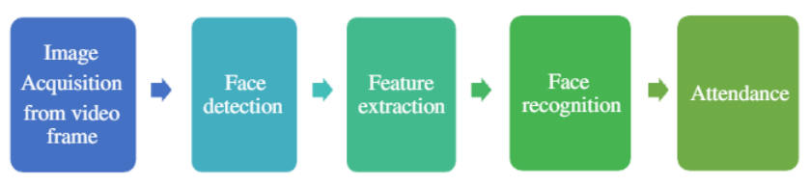
How the Dataset would be created?
The face segments from the images, captured from the WebCam, are detected.
The useful features of the face are recognized.
The features are classified and labelled.
The details(description of every student) are recorded for the collected data.
Note: We will take an already existing dataset from kaggle or create one from our own.

Slide 8
How the features are extracted:
We will take images and their variations as the input and convert them to gray scale to gather useful information extract valuable features using OpenCV library in Python.
We will choose the best quality picture among the variations of the images and assign file names based on their order of timestamps.
We will then train the model with these labelled images and store them in the database.

Slide 9
Algorithms Currently Used:
Haar Cascade Method- Used for Face detection to classify images into two categories- images containing faces and images of objects.
Local Binary Pattern Histogram (LBPH) - Face recognition is done using this method in which a 3x3 matrix window is moved along the image and the pixel value at the central location of the matrix is calculated.
Convolutional Neural Network (CNN) - face detection based on with face tracking and state of the art deep CNN face recognition algorithm like the RCNN, Fast RCNN, Faster RCNN, YOLO can be used based on the Region Proposal Network for generating the boundary boxes for the labels.

Slide 10
Algorithms Currently Used: (contd.)
Ensemble Learning : Ensemble learning is primarily used to improve the classification, prediction of an implementation. It’s a combination of VGG-FACE, OPENFACE, FACENET, DEEPFACE.
LightGBM : It is used to increase the accuracy of classification or prediction with the help of a gradient boosting framework.It is based on decision tree to increase the efficiency of the model and reduce memory.
HOG (Histogram of Oriented Gradients)-Feature descriptor with a linear SVM machine learning algorithm to perform face detection.It is fastest among all algorithm.But the main drawback is that doesn't detect accurately with odd angles and small faces.

Slide 11
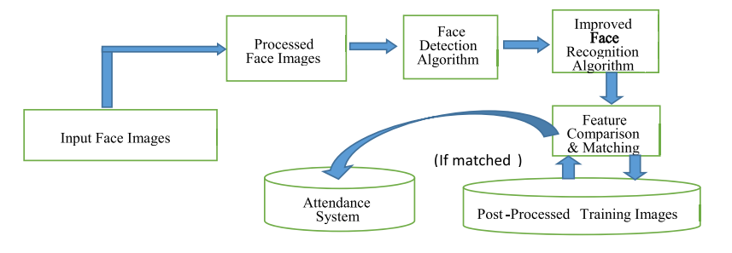
Flowchart

Slide 12
Essential Features
User Registration
User Authentication
Face Enrollment
Face Recognition
Attendance Recording
Attendance Updating

Slide 13
Future Scope
Integrate the system with the iris recognition to provide more accurate results.
Developing a mobile application for attendance tracker would provide greater flexibility and convenience. The user can check the attendance via a mobile app.
Doing the face recognition via video will provide better flexibility and usability instead of just taking images as a dataset and feeding the images into the system to get the results.
Providing enhanced security features like the 2-factor authentication where the message is given to the user phone to check if the user itself wants to access the website.

Slide 14
THANK YOU

